Slide 1
IT 356: Introduction To Computer Graphics (Lecture 09)
School of Information Technology
Illinois State University
Dr. Qi Zhang, Spring 2024

Slide 2
Shaders
Shaders are little programs that rest on the GPU.
These programs are run for each specific section of the graphics pipeline.

Slide 3

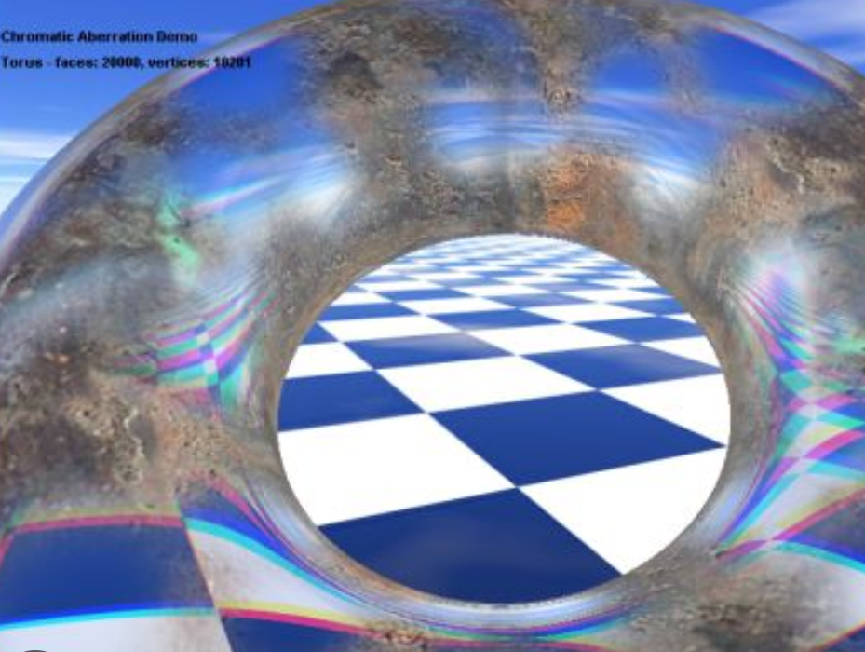
Shaders
In a basic sense, shaders are nothing more than programs transforming inputs to outputs.
Shaders are also very isolated programs in that they're not allowed to communicate with each other
The only communication they have is via their inputs and outputs.

Slide 4


OpenGL Shading Language (GLSL)
Shaders are written in the C-like language GLSL.
GLSL is tailored for use with graphics and contains useful features specifically targeted at vector and matrix manipulation.
https://www.khronos.org/opengl/wiki/OpenGL_Shading_Language

Slide 5
OpenGL Shading Language (GLSL)
Shaders always begin with a version declaration, followed by a list of input and output variables, uniforms, and their main functions.
Each shader's entry point is at its main function where we process any input variables and output the results in its output variables.

Slide 6
Vertex Shader: vshader_lec09_exp01.glsl
#version 460 core
//the position variable has attribute position 0
layout (location = 0) in vec3 aPos;
//specify a color output to the fragment shader
out vec4 vertexColor;
void main()
{
//see how we directly give a vec3 to vec4's constructor
gl_Position = vec4(aPos, 1.0);
//set the output variable to a dark-red color
vertexColor = vec4(1.0, 1.0, 0.0, 1.0);
}

Slide 7
Fragment Shader: fshader_lec09_exp01.glsl
#version 460 core
out vec4 FragColor;
// the input variable from the vertex shader (same name and same type)
in vec4 vertexColor;
void main()
{
FragColor = vertexColor;
}

Slide 8
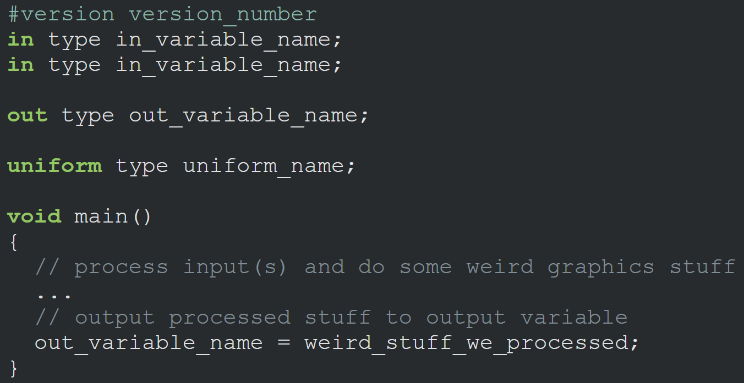
Shader Structure
A shader typically has the following structure:

Slide 9
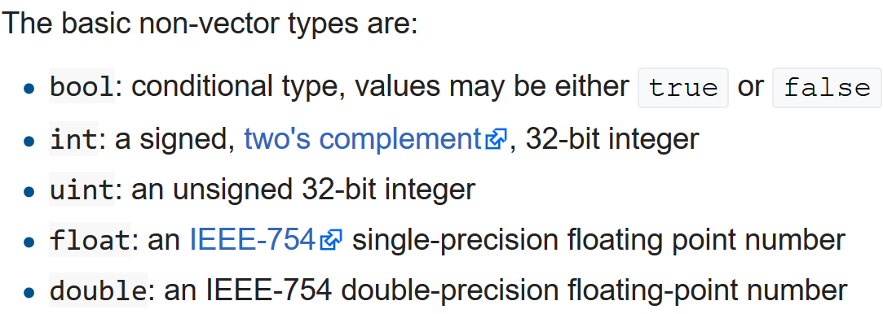
GLSL Types
Like any other programming language, GLSL has data types for specifying what kind of variable we want to work with.
GLSL has most of the default basic types we know from languages like C: int, float, double, uint, and bool.

Slide 10
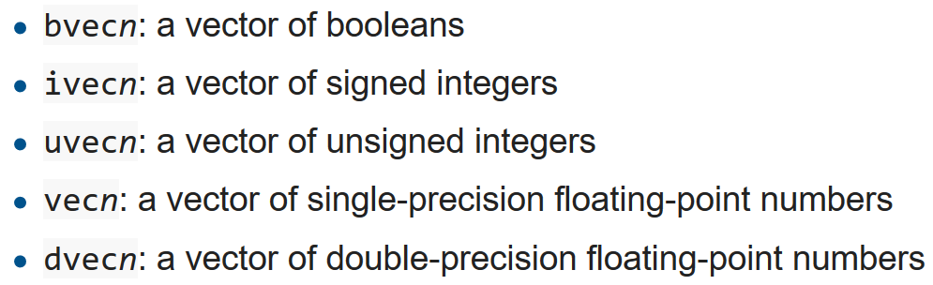
GLSL Types
GLSL also features two container types, namely vectors, and matrices.
A vector in GLSL is a 1,2,3 or 4 component container for any of the basic types.
They can take the following form (n represents the number of components):

Slide 11
Vectors
Components of a vector can be accessed via vec.x where x is the first component of the vector.
You can use .x, .y, .z and .w to access their first, second, third and fourth component, respectively.
GLSL also allows you to use rgba for colors or stpq for texture coordinates, accessing the same components.

Slide 12

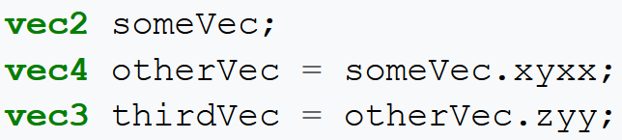
Vectors
The vector datatype allows for some interesting and flexible component selection called swizzling.
Swizzling allows for the following syntax:

Slide 13
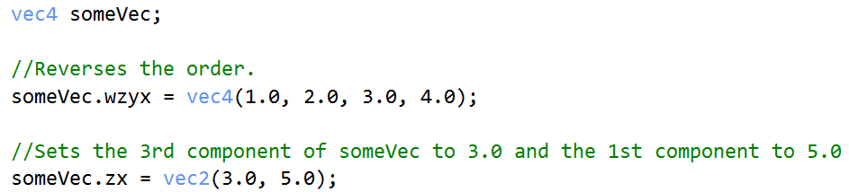
Vectors
There are 3 sets of swizzle masks.
You can use xyzw, rgba (for colors), or stpq (for texture coordinates).
These three sets have no actual difference.
You cannot combine names from different sets in a single swizzle operation. So ".xrs" is not a valid swizzle mask.

Slide 14
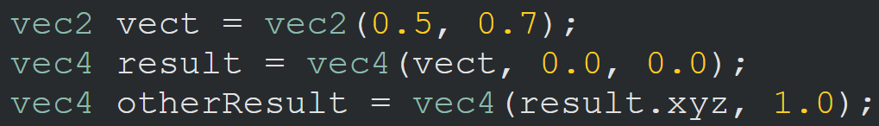
Vectors
You can use any combination of up to 4 letters to create a new vector (of the same type) as long as the original vector has those components
It is not allowed to access the .z component of a vec2 for example.
We can also pass vectors as arguments to different vector constructor calls, reducing the number of arguments required:

Slide 15
Ins and outs
Shaders are nice little programs on their own
They are part of a whole program
For that reason, we want to have inputs and outputs on the individual shaders. So that we can move stuff around.
GLSL defined the in and out keywords specifically for that purpose.
Each shader can specify inputs and outputs using those keywords and wherever an output variable matches with an input variable of the next shader stage they're passed along.
The vertex and fragment shader differ a bit, however.

Slide 16
Ins and outs
The vertex shader should receive some form of input, otherwise, it would be ineffective.
The vertex shader differs in its input, in that it receives its input straight from the vertex data.
To define how the vertex data is organized, we specify the input variables with location metadata to configure the vertex attributes on the CPU. We've seen this as layout (location = 0).
The vertex shader requires an extra layout specification for its inputs, so we can link it with the vertex data.
#version 460 core
//the position variable has attribute position 0
layout (location = 0) in vec3 aPos;
//specify a color output to the fragment shader
out vec4 vertexColor;
void main()
{
//see how we directly give a vec3 to vec4's constructor
gl_Position = vec4(aPos, 1.0);
//set the output variable to a dark-red color
vertexColor = vec4(1.0, 1.0, 0.0, 1.0);
}

Slide 17
Ins and outs
The fragment shader requires a vec4 color output variable, since the fragment shaders needs to generate a final output color.
If you'd fail to specify an output color in your fragment shader, OpenGL will render your object black (or white).
#version 460 core
out vec4 FragColor;
// the input variable from the vertex shader (same name and same type)
in vec4 vertexColor;
void main()
{
FragColor = vertexColor;
}

Slide 18
Ins and outs
If we want to send data from one shader to the other, we'd have to declare an output in the sending shader and a similar input in the receiving shader.
When the types and the names are equal on both sides, OpenGL will link those variables together. Then, it is possible to send data between shaders (this is done when linking a program object).
We will alter the shaders to let the vertex shader decide the color for the fragment shader.

Slide 19
Ins and outs
We declared a vertexColor variable as a vec4 output that we set in the vertex shader, and we declared a similar vertexColor input in the fragment shader.
Since they both have the same type and name, the vertexColor in the fragment shader (pixel shader) is linked to the vertexColor in the vertex shader.
#version 460 core
//the position variable has attribute position 0
layout (location = 0) in vec3 aPos;
//specify a color output to the fragment shader
out vec4 vertexColor;
void main()
{
//see how we directly give a vec3 to vec4's constructor
gl_Position = vec4(aPos, 1.0);
//set the output variable to a dark-red color
vertexColor = vec4(1.0, 1.0, 0.0, 1.0);
}
#version 460 core
out vec4 FragColor;
// the input variable from the vertex
// shader (same name and same type)
in vec4 vertexColor;
void main()
{
FragColor = vertexColor;
}

Slide 20
Ins and outs
We just managed to send a value from the vertex shader to the fragment shader.
We can send a color from our application to the fragment shader!

Slide 21
VBO, VAO, and Shader Program ID
//Vertex Buffer Object (VBO)
unsigned int VBO;
//Vertex Array Object (VAO)
unsigned int VAO;
//Shader Program (shaderProgram)'s ID
int shaderProgram;
//Return shaderProgram, which is used to set programID
shaderProgram = loadShader("../../src/shader/vshader_lec09_exp01.glsl",
"../../src/shader/fshader_lec09_exp01.glsl");
glGenVertexArrays(1, &VAO);
glGenBuffers(1, &VBO);

Slide 22
Data
//Set up vertex data (and buffer(s)) and configure vertex attributes
float vertices[] = {
-0.5f, -0.5f, 0.0f, //left
0.5f, -0.5f, 0.0f, //right
0.0f, 0.5f, 0.0f //top
};

Slide 23
Bind the Vertex Array Object
//Bind the Vertex Array Object first,
//then bind and set vertex buffer(s), and then configure vertex attributes(s).
glBindVertexArray(VAO);

Slide 24
Vertex Array Object and Vertex Attributes Pointers
//Copy our vertices array in a buffer for OpenGL to use
glBindBuffer(GL_ARRAY_BUFFER, VBO);
glBufferData(GL_ARRAY_BUFFER, sizeof(vertices), vertices, GL_STATIC_DRAW);
//Then set the vertex attributes pointers
glVertexAttribPointer(0, 3, GL_FLOAT, GL_FALSE, 3 * sizeof(float), (void*)0);
glEnableVertexAttribArray(0);

Slide 25
Use the Shader Program
//Use the shader program when we want to render an object
glUseProgram(shaderProgram);

Slide 26
Bind GL Array Buffer
//Note that this is allowed; the call to glVertexAttribPointer
//registered VBO as
//the vertex attribute's bound vertex buffer object so afterwards //we can safely unbind
glBindBuffer(GL_ARRAY_BUFFER, 0);

Slide 27
Bind Vertex Array and Draw Wireframe
//You can unbind the VAO afterwards, so other VAO calls won't accidentally //modify this VAO, but this rarely happens. Modifying other VAOs requires a //call to glBindVertexArray anyways.
//So we generally don't unbind VAOs (nor VBOs) when it's not directly //necessary.
glBindVertexArray(0);
//Draw in wireframe polygons.
glLineWidth(1);
glPolygonMode(GL_FRONT_AND_BACK, GL_LINE);

Slide 28
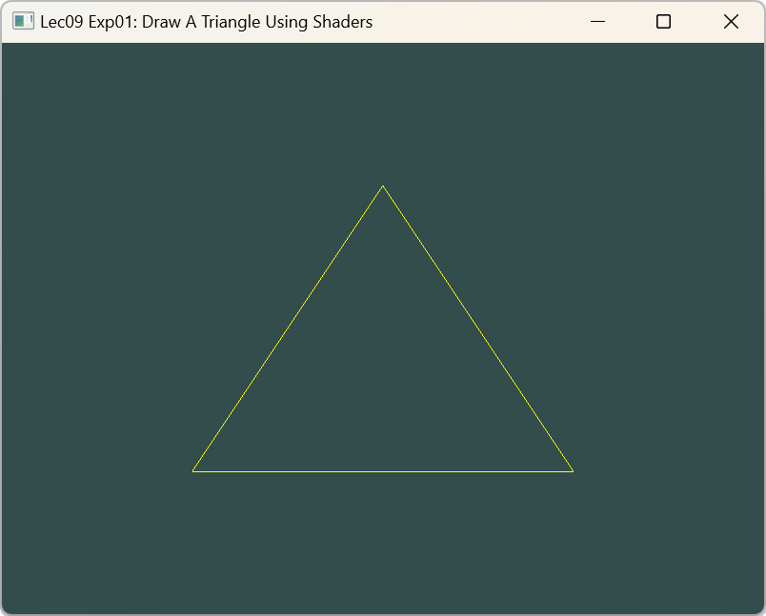
Draw A Triangle
//Draw our first triangle
//As we only have a single VAO, there's no need to bind it every time,
//But we'll do so to keep things a bit more organized
glBindVertexArray(VAO);
glDrawArrays(GL_TRIANGLES, 0, 3);
//No need to unbind it every time
glBindVertexArray(0);

Slide 29
Uniforms
Uniforms are another way to pass data from our application on the CPU to the shaders on the GPU, but uniforms are slightly different compared to vertex attributes.
First, uniforms are global, which means that a uniform variable is unique per shader program object and can be accessed from any shader at any stage in the shader program.
Second, whatever you set the uniform value, uniforms will keep their values until they're either reset or updated.

Slide 30
Uniforms
To declare a uniform in GLSL, we simply add the uniform keyword to a shader with a type and a name.
From that point on, we can use the newly declared uniform in the shader. Let's see if this time we can set the color of the triangle via a uniform.
We declared a uniform vec4 ourColor in the fragment shader and set the fragment's output color to the content of this uniform value.
#version 460 core
out vec4 FragColor;
//we set this variable in the OpenGL code.
uniform vec4 ourColor;
void main()
{
FragColor = ourColor;
}

Slide 31
Uniforms
Since uniforms are global variables, we can define them in any shader we'd like
No need to go through the vertex shader again to get something to the fragment shader.
We're not using this uniform in the vertex shader, so there's no need to define it there.
#version 460 core
layout (location = 0) in vec3 aPos;
void main()
{
gl_Position = vec4(aPos.x, aPos.y, aPos.z, 1.0);
}

Slide 32
Uniforms
We first need to find the index/location of the uniform attribute in our shader.
Once we have the index/location of the uniform, we can update its values.
Instead of passing a single color to the fragment shader, we can gradually change color over time:
// update shader uniform
float timeValue = glfwGetTime();
float greenValue = sin(timeValue) / 2.0f + 0.5f;
int vertexColorLocation = glGetUniformLocation(shaderProgram, "ourColor");
glUniform4f(vertexColorLocation, 0.0f, greenValue, 0.0f, 1.0f);
First, we retrieve the running time in seconds via glfwGetTime().
Then we vary the color in the range of 0.0 - 1.0 by using the sin function and storing the result in greenValue.

Slide 33
Uniforms
Then we query for the location of ourColor uniform using glGetUniformLocation.
We supply the shader program and the name of the uniform (that we want to retrieve the location from) to the query function.
If glGetUniformLocation returns -1, it cannot find the location.
// update shader uniform
float timeValue = glfwGetTime();
float greenValue = sin(timeValue) / 2.0f + 0.5f;
int vertexColorLocation = glGetUniformLocation(shaderProgram, "ourColor");
glUniform4f(vertexColorLocation, 0.0f, greenValue, 0.0f, 1.0f);

Slide 34
Uniforms
Lastly, we can set the uniform value using the glUniform4f function.
Note that finding the uniform location does not require you to use the shader program first, but updating a uniform does require you first to use the program (by calling glUseProgram) because it sets the uniform on the currently active shader program.
// update shader uniform
float timeValue = glfwGetTime();
float greenValue = sin(timeValue) / 2.0f + 0.5f;
int vertexColorLocation = glGetUniformLocation(shaderProgram, "ourColor");
glUniform4f(vertexColorLocation, 0.0f, greenValue, 0.0f, 1.0f);

Slide 35
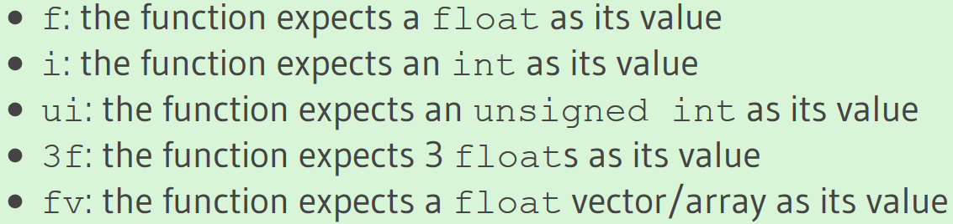
Uniforms
Because OpenGL is in its core a C library, it does not have native support for type overloading
Wherever a function can be called with different types, OpenGL defines new functions for each type required
The glUniform is a perfect example of this. The function requires a specific postfix for the type of the uniform you want to set. A few of the possible postfixes are:

Slide 36
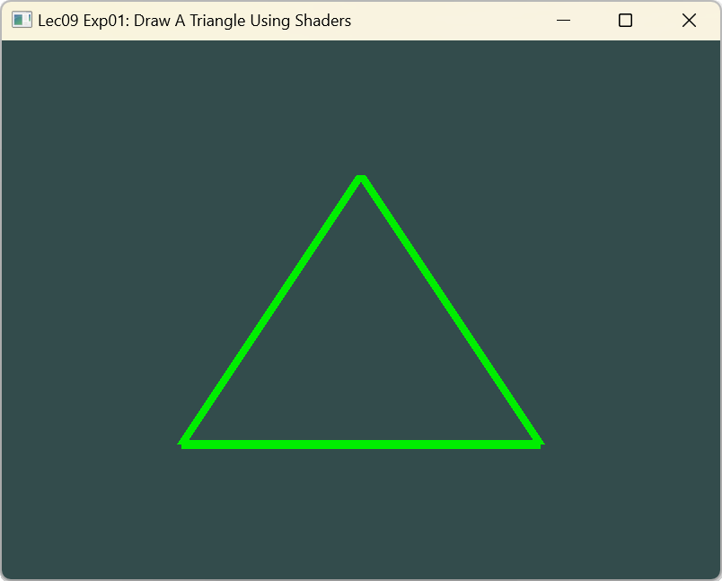
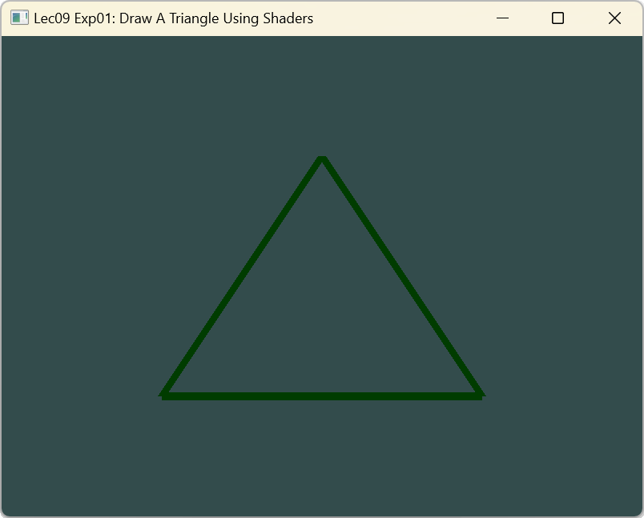
Uniforms
Now that we know how to set the values of uniform variables, we can use them for rendering.
If we want the color to change gradually, we want to update this uniform every game loop iteration (so it changes per-frame),
Otherwise, if we only set it once, the triangle would maintain a single solid color. So, we calculate the greenValue and update the uniform each render iteration:

Slide 37
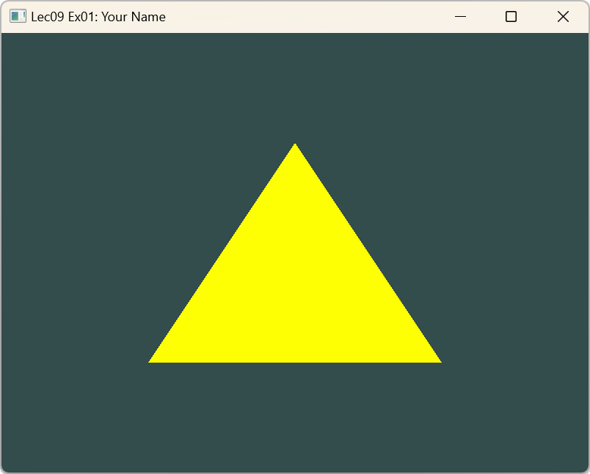
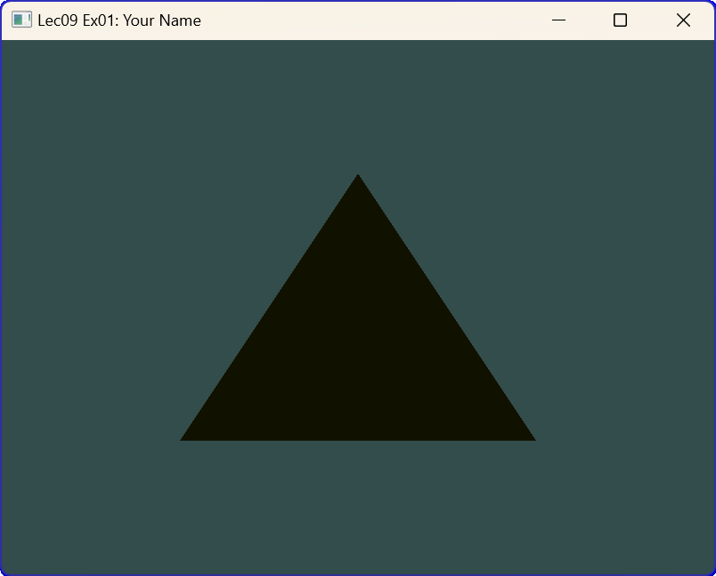
Exercise 1

Slide 38
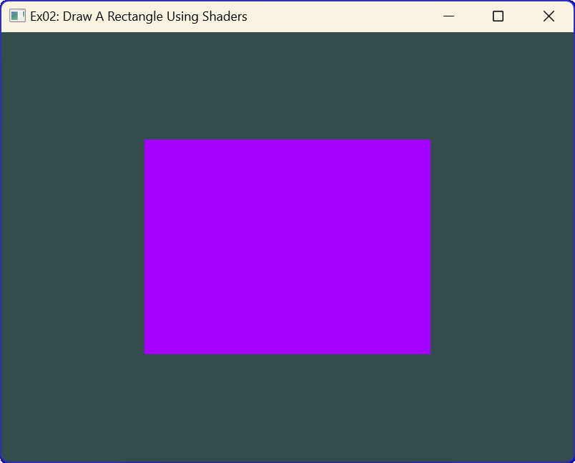
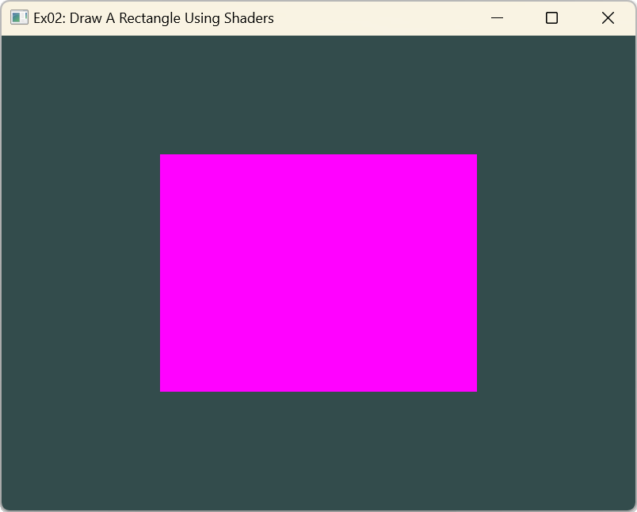
Exercise 2

